Slide 1

Make video as big as the red frame, place it under the headline..
All text in green box to be placed under the video.

Slide 2
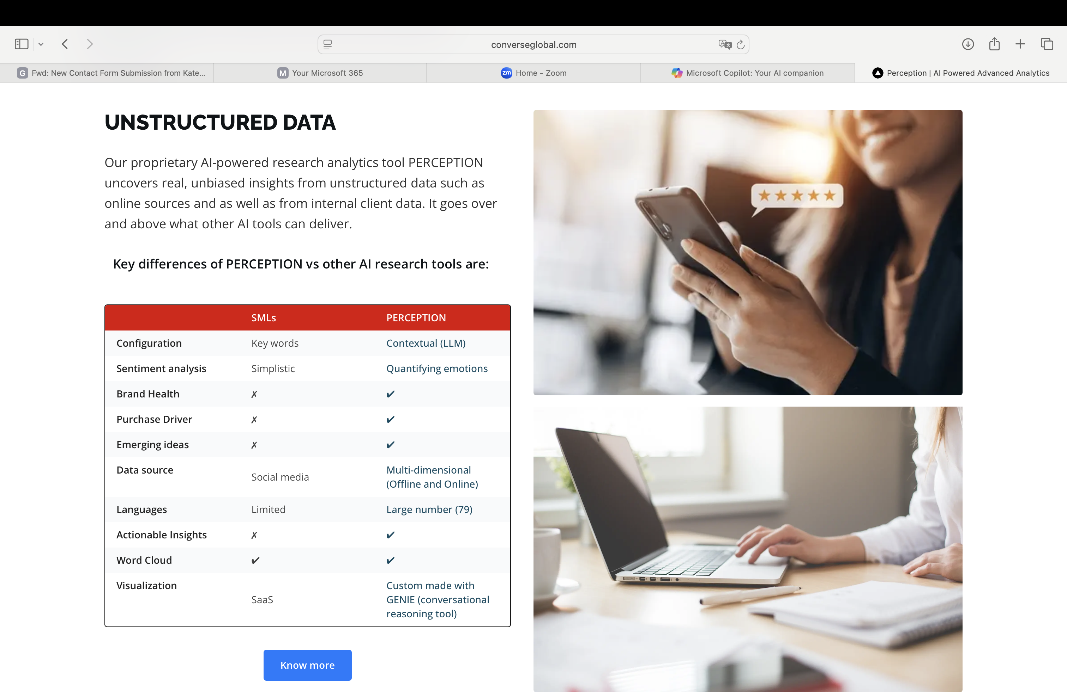
Make the pictures slightly smaller (about the same size as the blue boxes)

Slide 3
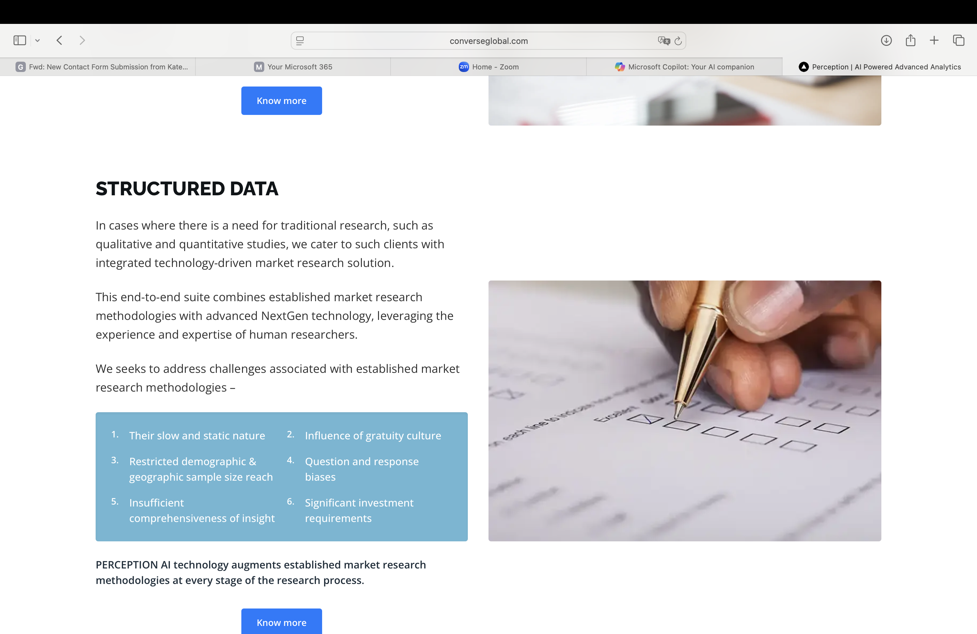
Make the picture slightly smaller (about the same size as the blue boxes)

Slide 4
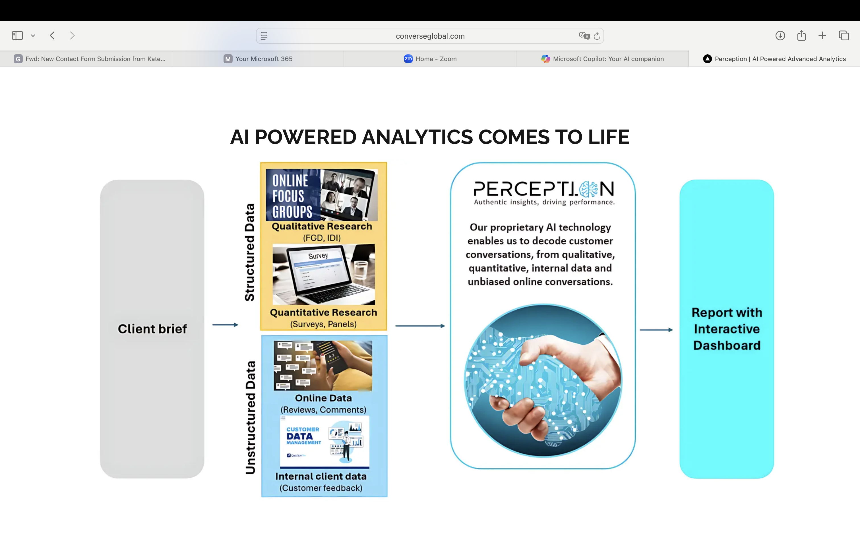
Increase space slighty between headline and visual

Slide 5
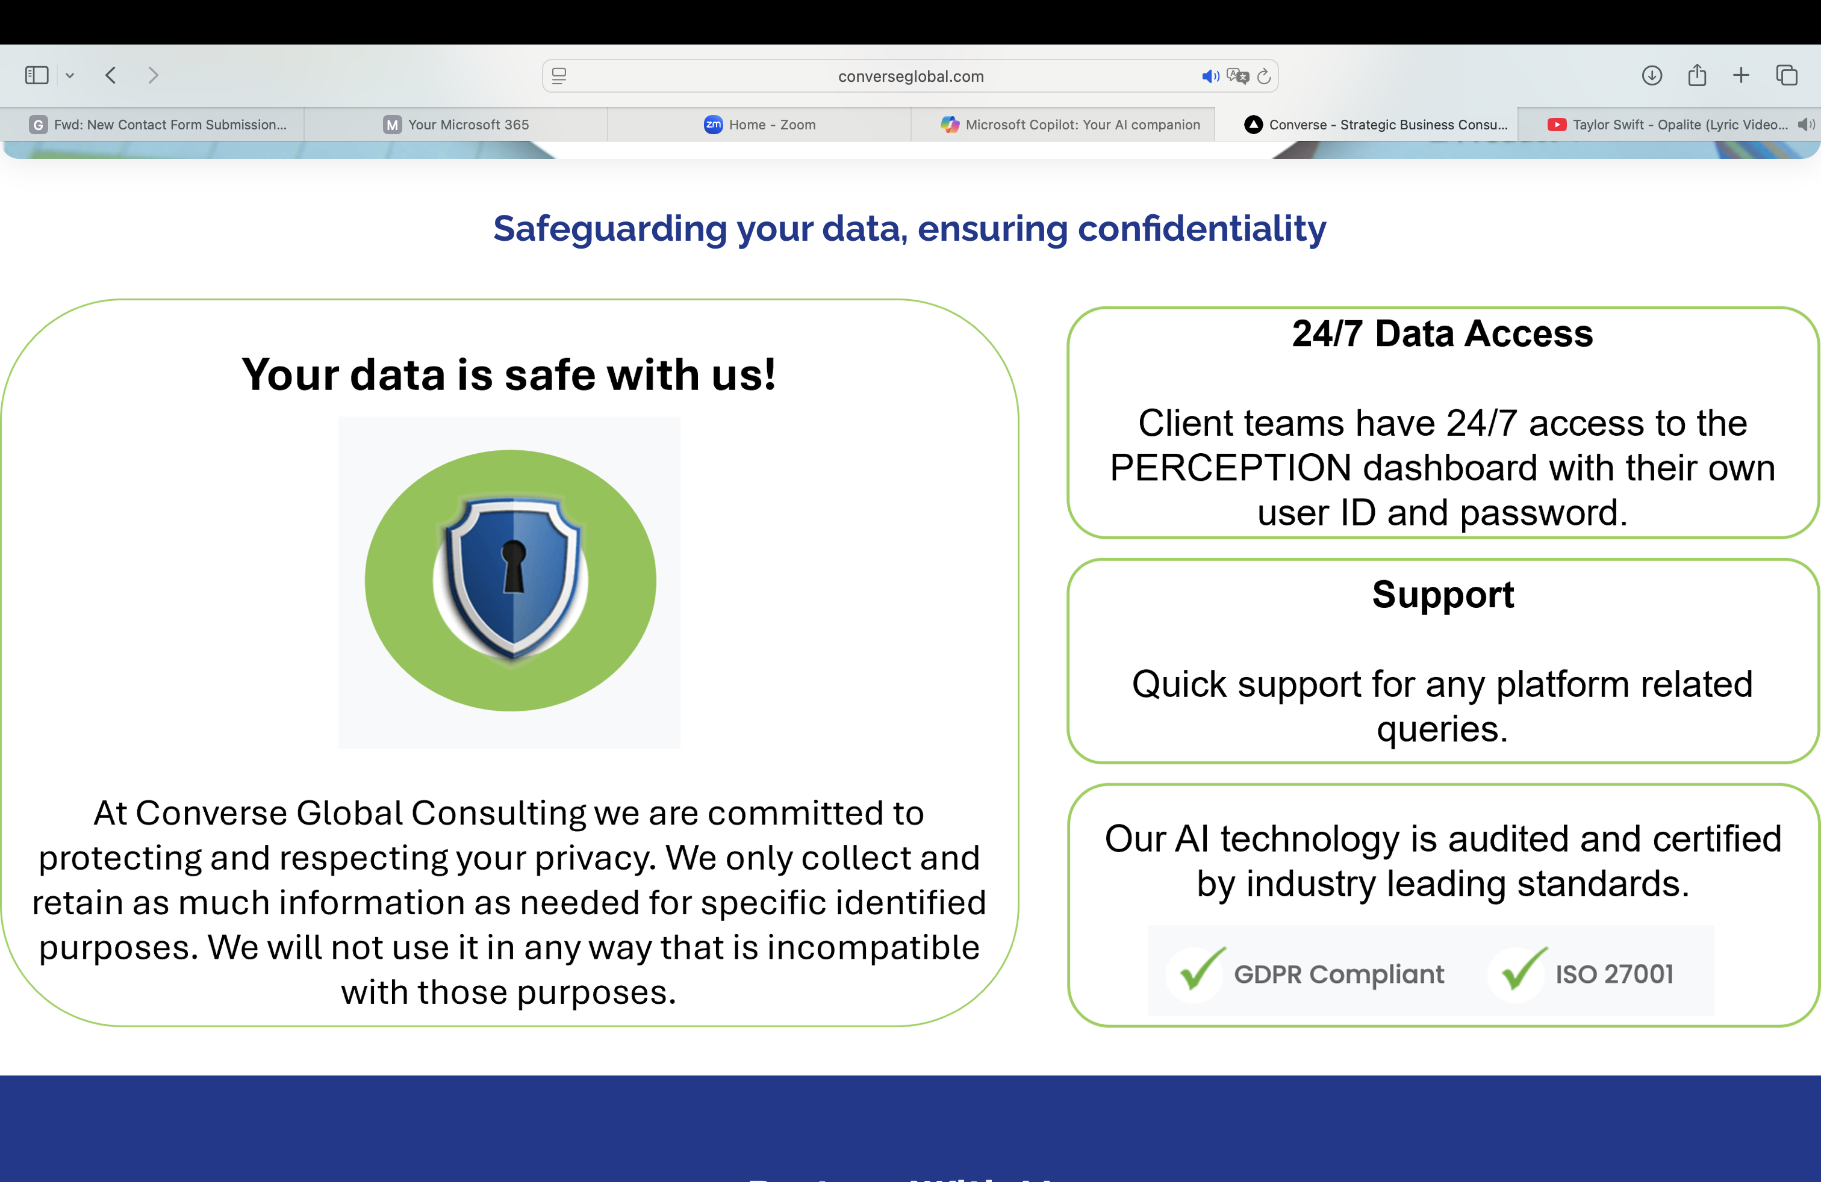
Headline to be written in capital letters
Copy to be adjusted to the size of the copy in the “who we are” section

